Slide 1


Delivering effective and efficient
Grants Management

Slide 2

Company Profile
Pangea Consulting established since 2000 by experienced team of Consultants
Specialise in supporting organisations in Not for Profit and Charity sector for over 20 years
Deliver fully customisable solutions that empower clients to make better use of their data
Experienced team of Consultants specializing in delivering end to end project life cycle expertise to meet customer requirements
Exclusive relationship with Neetrix to deliver fully customizable software solutions
Headquartered in Gloucestershire, UK

Slide 3









Pangaea Client History – 19 - 2020
1990 1992 1995 2000 2005 2008 2010 2012 2015 2018 2020

Slide 4





Platform Capability
Grants Management
Applications Management
Fundraising
CRM Contacts
Contact Management
Customer Communications
Groups
Pipeline Management
Subscriptions
Campaign Management
Workflow
Reporting
Exports
Store Front
E-Commerce
Product Management
Stock Control
Sales and Purchasing Automatic Email reminders for Overdue Invoices
Payment Integration (World Pay, Paypal, Stripe)
Real time update of stock levels
Back Office
Flexible Business Process Management Workflow Automation
Workboards and Dashboards
Automation of manual processes
Jobs and Projects management
Events and Schedule management

Slide 5



Grant Management Features
Application Management
Manage incoming applications efficiently.
Link online applications directly into back office systems.
Keep applicants informed throughout the process
Workflow and Process Automation
Easily control your due diligence, review and approval process
Automatically email applicants as they move through stages
Give reviewers and committees access to all information they need to make decisions
Get up to date status of application state
Monitoring and Analysis
On awarding of grant the system monitors how this has changed peoples lives using scheduled communications
Using data stored to analyse exactly where and how you are making a difference giving tools for improved planning

Slide 6

Case Study Date - 2020
Background
The National Benevolent Charity(NBC) provides financial help and manages supported-housing type accommodation in Gloucestershire. The core service which triggered the project is a welfare fund scheme. Pangaea were referred to NBC who had asked for help in changing their business capability from a mainly paper based process to one which made use of technology. They wanted to improve their responsiveness to applicants, manage funding activity and enable better analysis and planning for future grant making programmes.
Our Approach
Pangaea initiated meeting with the senior management team to listen to how their existing processes worked, learn who was involved and understand the vision for the future. The outcome was a document containing a set of high-level requirements which was used to shortlist suitable technology solutions that met the driving principles of ease of use, flexible, cost effective and meeting immediate requirements as well as having scope for growth. The technology platform selected was Neetrix (a cloud-hosted CRM and business management system) as it met all the above requirements. One of the key tenets of successful project management is that involvement of key users is vital –with that in mind a quick demonstration of the system was set up so that all staff could see and become familiar with the system capabilities, ask questions and add any suggestions/requests
Client Feedback
“I'm very grateful for all your work on Neetrix...it’s made a massive difference to our delivery of grants and information storage. “Ali Russell Chief Executive NBC

Slide 7
Business Case
  *50-80% improvement of data capture and accuracy due to reduction of manual process
  *50% increase in staff productivity due to automation of task management
  Better Grant Information Reporting and delivery of Metrics to Senior Management
  Improved tracking and status of grants throughout the lifecycle
  Better understanding of customers as leveraging grants information for cross functional systems ie Accounting, CRM, E-commerce
  Based on figures from National Benevolent Charity

Slide 8
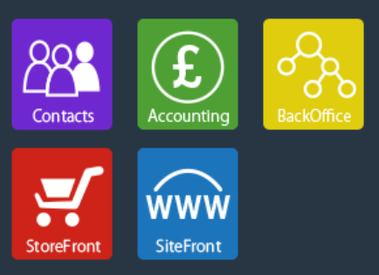
Neetrix Technical Features
Fully hosted service
24/7 access for anywhere in the world Internet
100GB of data easily upgradeable
99% Average Monthly UP time of service
All Data is backed up daily, onsite and in 2 off site remote locations
Multi Level User authorities
Full Site setup is provided
System will receive free BAL created system upgrades
Secure Login for Organisation users with
encrypted system
Full Online manual
Unlimited Grants Categories,
Unlimited Subcategories
Unlimited Users (no seat licenses),
Unlimited Applications
Online Helpdesk
Always have latest version of Software
Users can easily find all the functionality and actions using Bas How to Guides
The interface navigation is simple and intuitive to use
Complete search abilities throughout the system

Slide 9
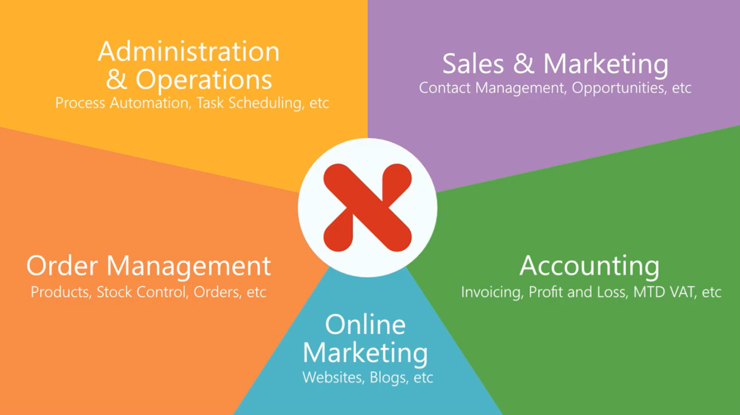
Other Available Modules

Slide 10

For further information please contact:
Hanif Patel – hanif@pangaea-consulting.com
Mark Corfield - mcorfield@pangaea-consulting.com

